Slide 1

SINGAPORE RESALE FLAT PRICE PREDICTION BY- PRAKASH.K

Slide 2

Project Summary :
The objective of this project is to develop a machine learning model and deploy it as a user-friendly web application that predicts the resale prices of flats in Singapore. This predictive model will be based on historical data of resale flat transactions, and it aims to assist both potential buyers and sellers in estimating the resale value of a flat.

Slide 3
SYNOPSIS :
Getting Data
Data Wrangling
Data Preprocessing
EDA
Feature Selection
Model Building
Model Deploying

Slide 4
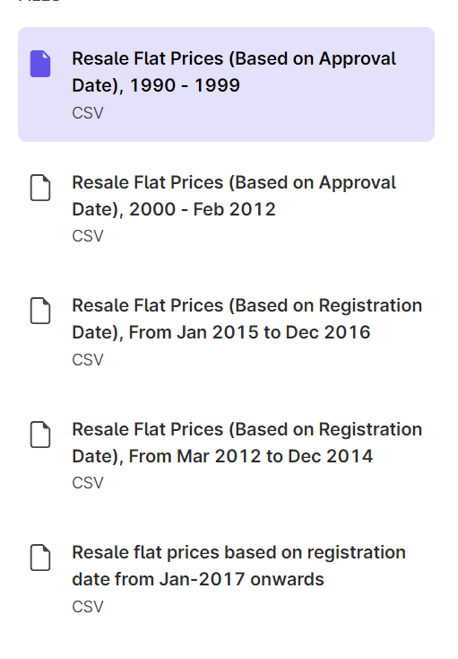
Getting Data:
The process of getting data is simply downloading the data sets from the government website www.data.gov.sg, An official website hosted by singapore government.
The data set is divided into five files, we have to download the files and store it in the required place for further processes.

Slide 5
Data Wrangling:
Data wrangling is the process of transforming and structuring data from one raw form into a desired format with the intent of improving data quality and making it more consumable and useful for analytics or machine learning.
Here we just combining the given data sets into one for improving the performance and the model building. The further process of Data Wrangling will be done in the pre processing stage.

Slide 6
Pre Processing the Data:
Data preprocessing, also known as data preparation or cleaning, is the process of converting raw data into a format that's usable for analysis. It's an important step in any data science project to ensure that data quality is consistent before using machine learning or data mining techniques.
And we need to remove skewness and outliers in the data set. I used log transformation to handle the skewness and z-score method to eliminate the unwanted outliers without causing changes in the available data. This helps to improve the performance of the ML model.
In this process we also encode the object type data to float or int using some encoders like Onehot Encoder, Ordinal encoder and some more we can use. In this project I used Ordinal Encoder for data encoding.

Slide 7
Exploratory Data Analysis (EDA):
Exploratory Data Analysis (EDA) refers to the method of studying and exploring record sets to apprehend their predominant traits, discover patterns, locate outliers, and identify relationships between variables. EDA is normally carried out as a preliminary step before undertaking extra formal statistical analyses or modeling.
I also given some good graphs to explain the data distribution over the resale price and which features are affecting the price. The graps will help to understand the data properly
We can use the Corelation heatmap to select the features for the machine learning model building.

Slide 8
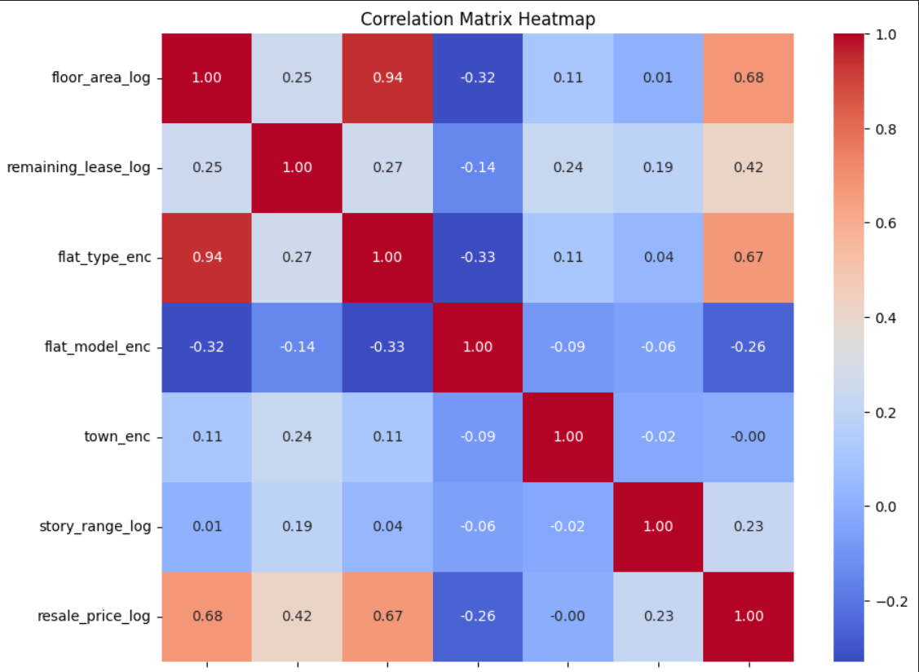
Feature Selection:
We are selecting the feature with the help of correlation heatmap. The featuress must be in the data type of float or integers only, Which can only be used for training and testing data sets.
The selected features will be split into training and testing datasets for the regression model. The data has to be scaled befor using for the prediction

Slide 9
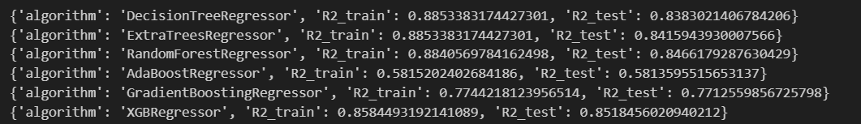
ML-Model Building:
This is the core and the most crucial part of this project. Initial step in model building is to select the best regressor. The best regressor will chosen by the higher R2 value. So I am testing the training and testing data sets with the following ML models for R2 score.
Decision Tree Regressor
Extra Trees Regressor
Random Forest Regressor
Gradient Boosting Regressor
Ada Boosting Regressor
XGB Regressor

Slide 10
ML-Model Building:
I got the highest R2 value on XGB Regressor. So I am going to select the XGB regressor for model building. Before that iam going to select the besty parameter for the regressor by using the Parameter GridSearch method. By using the parameter grid search method the actual performance of the training and testing data will be further increased. Please note the higher parameter will consume more time to finish the model execution.
After this process the best parameter will be selected as prediction model we can test the model using some random testing data respective to the selected features.
The final step of model building is to save the ML model in a pickle file. Which helps to save the finished model to use it without any pre-executions.

Slide 11
Model Deployment / Streamlit App Building:
This is the final process of this project. This helps to showcase the project and predict the resale price.
Here I am creating a Streamlit app using python for model deployment and displaying the analysis of the given data. This streamlit app has three sections which are Home, Analysis and the Resale Price Predict sections. The Home explains about the App and the project, Analysis helps to show the graphs, and The Price Prediction section is the one I actually deployed the model using pickle file which I already saved the regression model.
I also posted this app in the in the streamlit cloud comunity.
App Link : https://singaporeresaleflatpriceprediction-iyfnegtqke3keuuyb5bwyx.streamlit.app/
You can clone my repository and run the link this app will work on any system and it will automatically install the required files also.

Slide 12
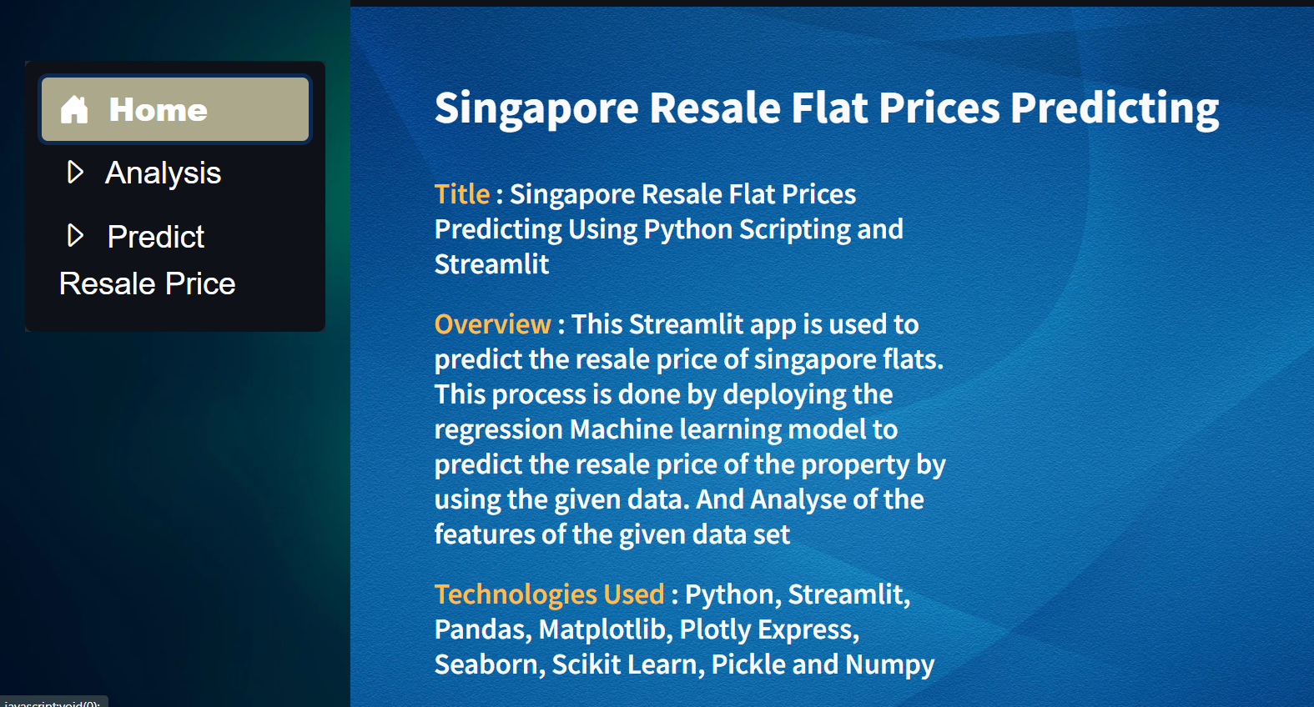
Model Deployment / Streamlit App Building:

Slide 13
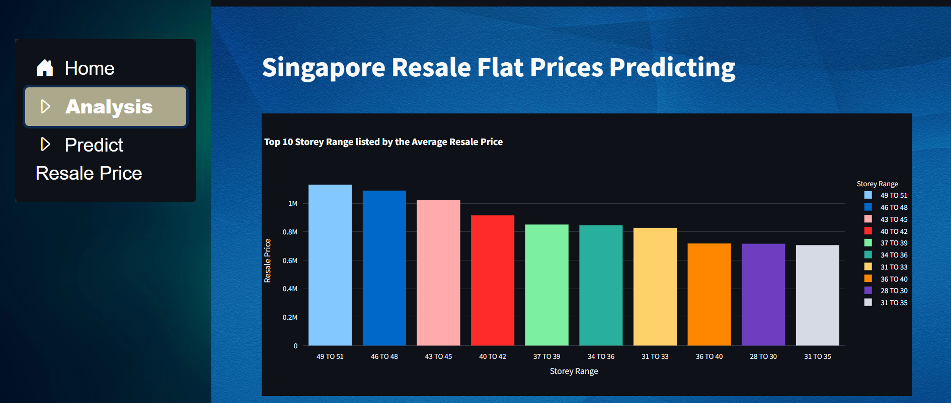
Model Deployment / Streamlit App Building:

Slide 14
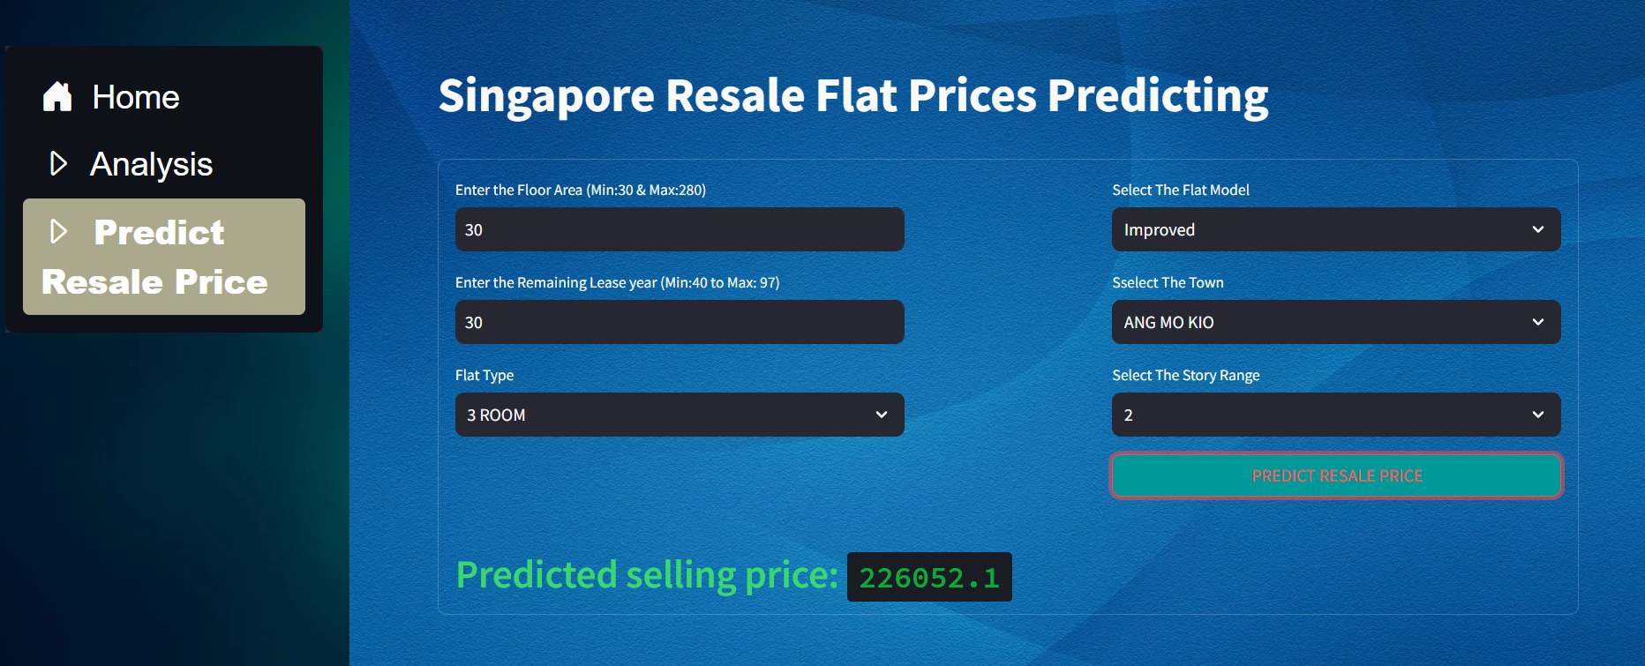
Model Deployment / Streamlit App Building:

Slide 15
THANKING YOU

